Slide 1
Energy efficient UDN design using reinforcement learning
BongSang Kim
Jaehyun Lee
DGIST
tph02361@dgist.ac.kr
dlwogus4066@dgist.ac.kr
25/July/2019
Summer Internship
Final Presentation

Slide 2
Outline
Overview
Background
Objectives
UDN design
System Model
RL setup
Results
Future Study
Plan

Slide 3
Part 1
Overview

Slide 4
Background : Ultra Dense Network(UDN)
Ultra Dense Network(UDN)
Dense and massive deployment of BSs
Has Higher data rates and enhanced coverage
BS–to –UE Ratio is higher than traditional cellular network
Due to the densification of BSs, BS have LoS/NLoS path
Turning off surplus BS can increase data rates considering interferences

Slide 5
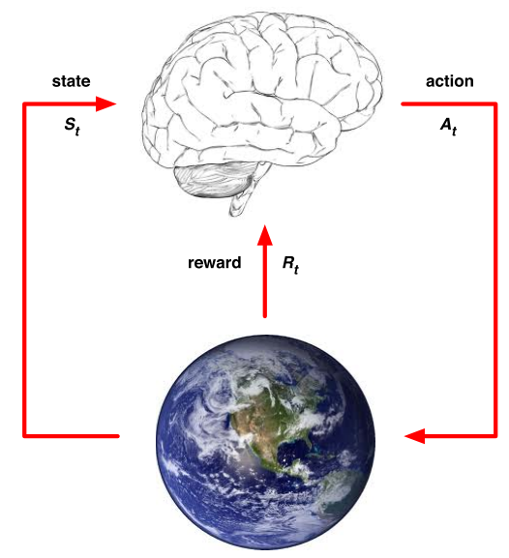
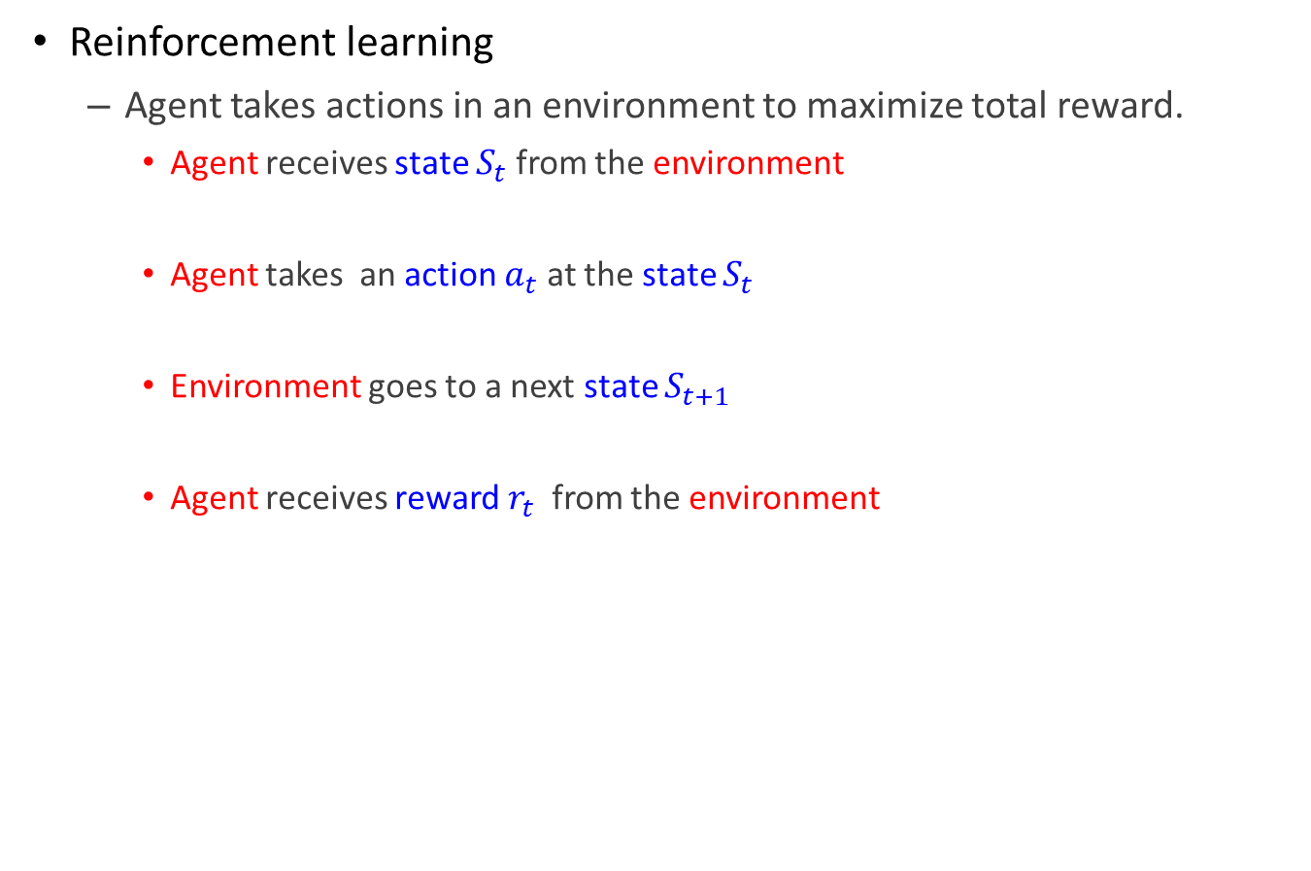
Background : Reinforcement Learning(RL)
Reinforcement learning
Agent takes actions in an environment to maximize total reward.
Agent receives state $S_{t}$ from the environment
Agent takes an action $a_{t}$ at the state $S_{t}$
Environment goes to a next state $S_{t+1}$
Agent receives reward $r_{t}$ from the environment

Slide 6
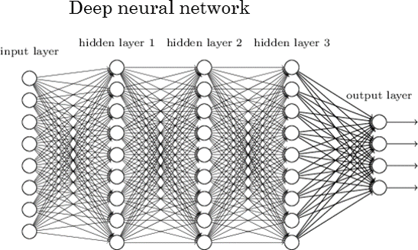
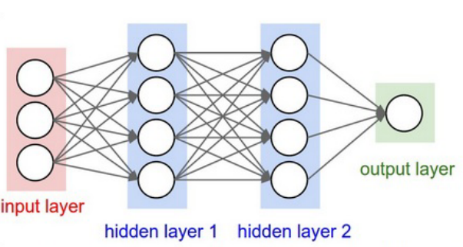
Background : DQN algorithm
Deep Q Network(DQN)
Update action-value function
Choose deep neural network as non-linear function approximator
of action-value(Q) function
Value based method
Notes:
강화학습에서 agent는 environment를 MDP를 통해서 이해를 하는데 table 형태로 학습을 모든 state에 대한 action-value function의 값을 저장하고 update시켜나가는 식으로 하면 학습이 상당 히 느려집니다. 따라서 approximation을 하게되고 그 approximation방법 중에서 nonlinear function approximator로 deep neural network가 있습니다. 따라서 action-value function(qvalue)를 approximate하는 방법으로 deep neural network를 택한 reinforcement learning방법이 Deep Reinforcement Learning(deepRL)입니다. 또한 action value function뿐만 아니라 policy 자체를 approximate할 수도 있는데 그 approximator로 DNN을 사용해도 DeepRL이 됩니다.

Slide 7
Objectives
Energy efficient UDN environment design
BSs consume energy in proportion to the # of active BSs
Data rates increase as active BSs increase
However, the densification of BSs in UDN cause stronger interference
UDN efficiency decreases
Find optimal BS on/off strategy in UDN using DQN algorithm

Slide 8
Part 2
UDN design

Slide 9
UDN Environment Modeling
Parameters
Control Area = ${10}^{4}m^{2}$
Users = 16
BS number = 6
Interference BS number =64
Interference BS state = Random on/off in each state
BS location is PPP($λ={10}^{−3}m^{2}$)
First user position = random position in control area
User location change = walking model
User-BS association rule: nearest BS association
Bandwidth = 10$MHz$
Path loss exponential factor = -4

Slide 10
UDN Environment Modeling
Channel model
Path loss model
User received signal power = $h\left(x\right)×d^{−4}$
$d:distance between connected BS and user$
$h\left(x\right):BS transmit power$
User received interference power = $\sum_{i=1}^{n}{h\left(x\right)×{d′[i]}^{−4}}$
$d′\left[i\right]:distance between interference BS[i] and user$
$h\left(x\right):BS transmit power$
SIR = $\frac{h\left(x\right)×d^{−4}}{\sum_{i=1}^{n}{h\left(x\right)×{d′[i]}^{−4}}}=\frac{d^{−4}}{{d′[i]}^{−4}}$
Data rate at user k = $R_{k}=W_{b}×\log_{2}{(1+SIR)}$

Slide 11
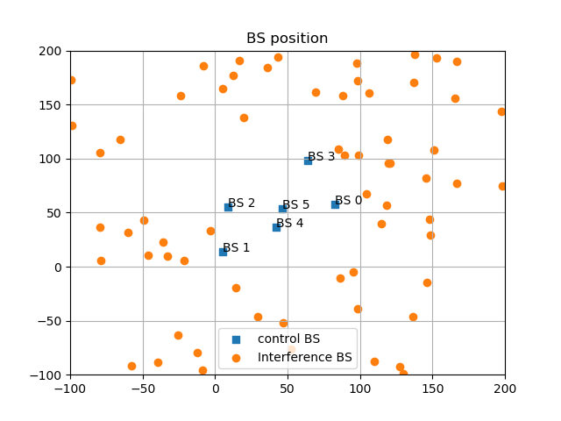
UDN Environment Modeling

Slide 12
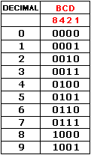
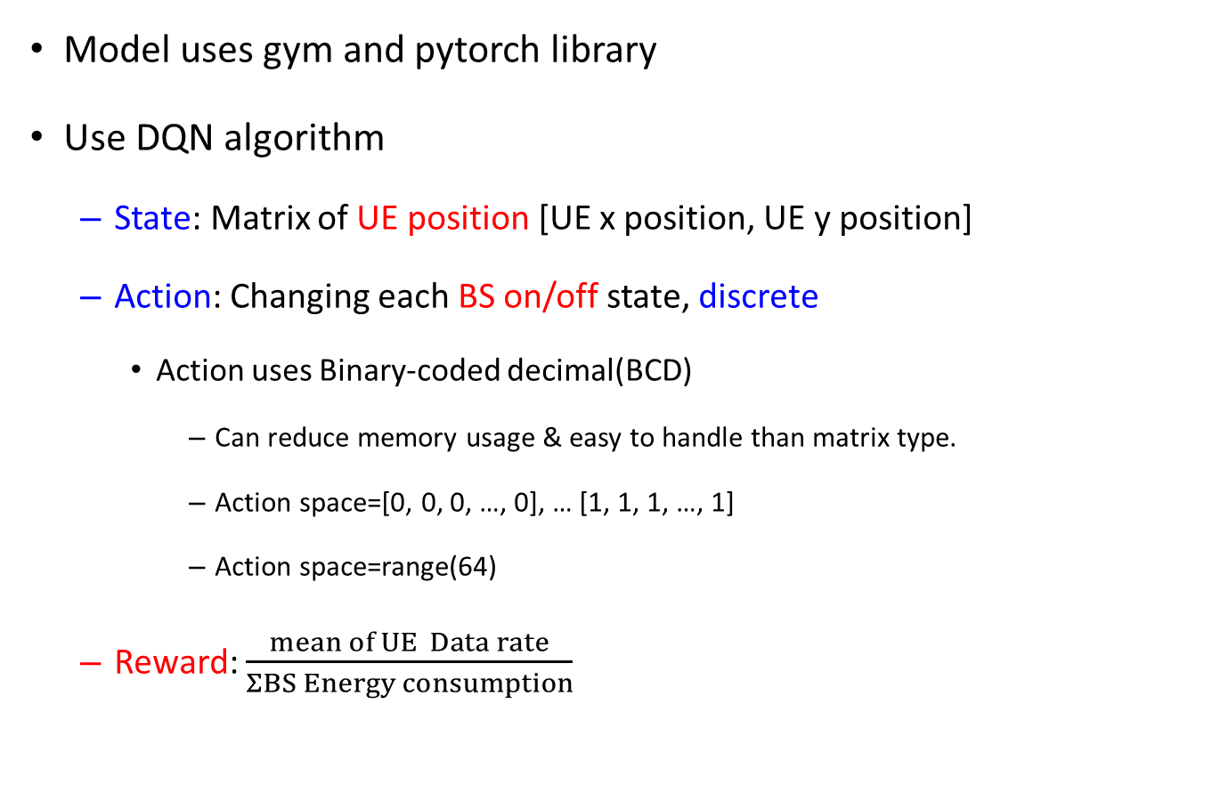

RL setup
Model uses gym and pytorch library
Use DQN algorithm
State: Matrix of UE position [UE x position, UE y position]
Action: Changing each BS on/off state, discrete
Action uses Binary-coded decimal(BCD)
Can reduce memory usage & easy to handle than matrix type.
Action space=[0, 0, 0, …, 0], … [1, 1, 1, …, 1]
Action space=range(64)
Reward: $\frac{mean of UE Data rate}{ΣBS Energy consumption}$
$$2^{BSnum}$$
Notes:
BCD는 이진화 십진법

Slide 13
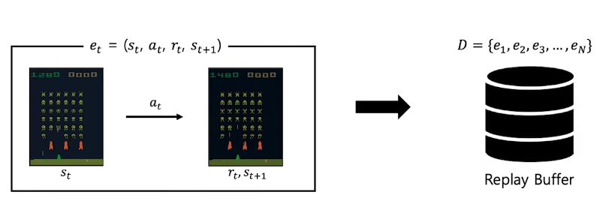
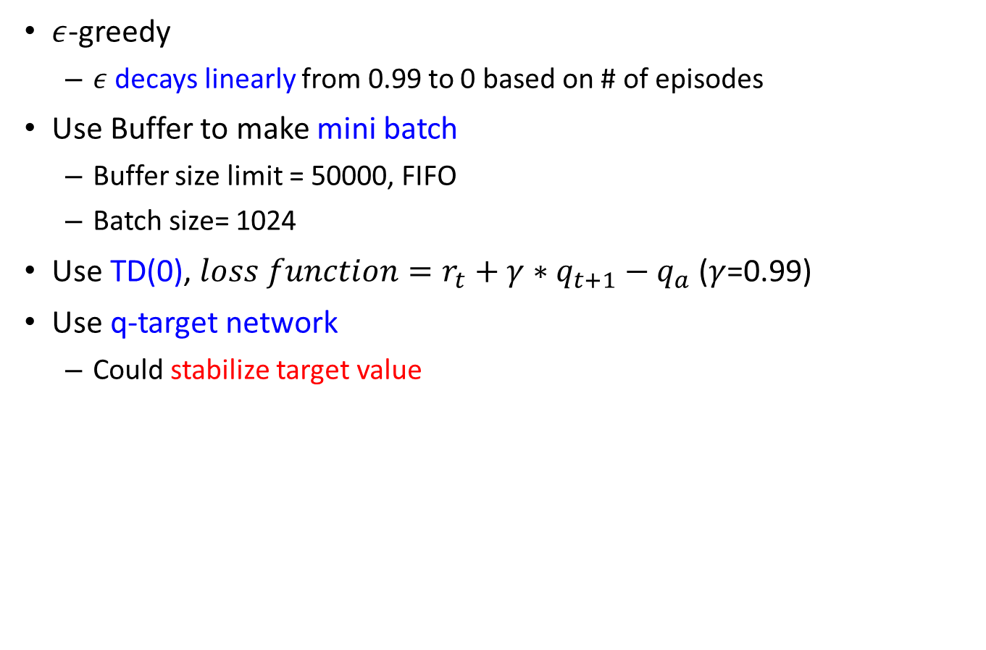
RL setup
$ε$-greedy
$ε$ decays linearly from 0.99 to 0 based on # of episodes
Use Buffer to make mini batch
Buffer size limit = 50000, FIFO
Batch size= 1024
Use TD(0), $loss function=r_{t}+γ∗q_{t+1}−q_{a}$ ($γ$=0.99)
Use q-target network
Could stabilize target value
Notes:
Epsilon greedy에서 엡실론 값은 0.99-0.1*(episode_number)/700을 따른다. 근데 이건 에피소드 개수따라 달라져야 해서 전체에피소드의 70%는 nonzero epsilo값이고, 30%는 zero값인 epsilon으로 학습
엡실론 decay를 사용하면 학습 초기에 exploration을 크게 늘릴 수 있고, overfitting을 방지할 수 있다.
하지만 TD에서는 실제 보상과 다음 step에 대한 미래추정가치를 사용해서 학습을 하게 됩니다.
이때 사용하는 보상과 value function의 합을 TD target이라고합니다.
그리고 이 TD target과 실제 V(S)와의 차이를 TD error 라고 하고 델타라고 표현을 합니다.
https://computer-nerd.tistory.com/46

Slide 14


RL setup
Use DQN algorithm
Neural network design
Use fully connected network
# of input nodes is dimension of state, which is $2×(UEnum)$
# of hidden layer nodes is 100 each, has 2 hidden layer
# of output nodes is dimension of possible actions, which is $2^{BSnum}$
64(=$2^{6}$)
Q
Fully Connected
100
Hidden layer 2
Fully Connected, ReLu
100
Hidden layer 1
Fully Connected, ReLu
32
Input

Slide 15
RL setup
4 python module
main.py: DQN algorithm code
UDN_env.py: gym environment
BSppp.py: create BSposition.csv
Information of BS position
InterferenceBSppp.py: create InterferenceBSposition.csv
Information of interference BS position

Slide 16
RL setup-Structure-main.py
Class : Qnet(nn.Module)
__init__
Construct neural network
forward
Select activation function - ReLu
sample_action
$ε$ -greedy
Class : Replay Buffer
Buffer stores $\left\{e_{1 },e_{2},…,e_{50000}\right\}, e_{t}=\left\{s_{t}, a_{t}, r_{t}, s_{t+1}\right\}$
train
Update q function – use mini batch and q-target network
main
Import gym_UDN, initialize parameters, run DQN

Slide 17
RL setup-Structure-UDN_env.py
Class : UDNEnv
__init__
Initialize parameters, BS/UE position
step
Calculate BS distance, Energy consumption, SIR, Reward
reset
Reset parameters(state, UE position)
association
Associate BS-UE by association rule
usermovedistance
Move UE at some distance from current location
take_action
Return the state according to action
Interference_User_I
Return interference of each UE

Slide 18
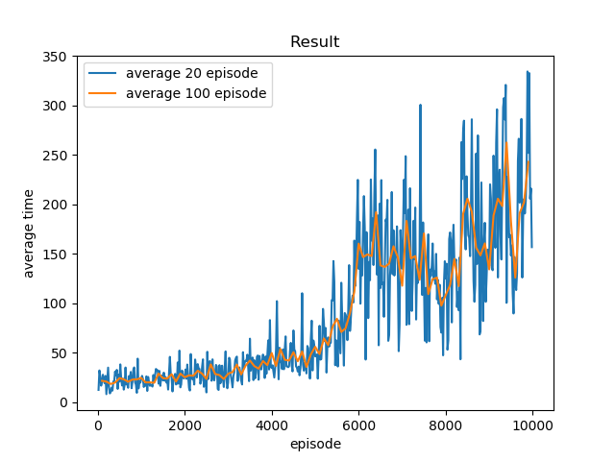
Simulation Result terminate at 10000 episode

Slide 19
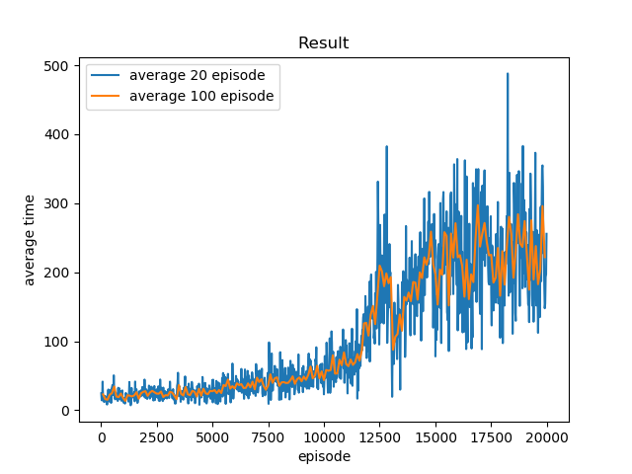
Simulation Result terminate at 20000 episode

Slide 20
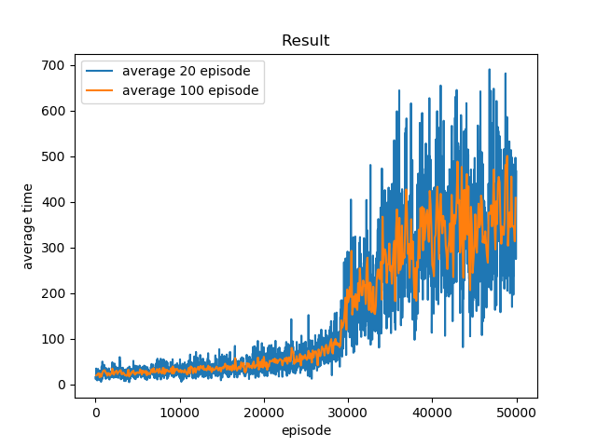
Simulation Result terminate at 50000 episode

Slide 21
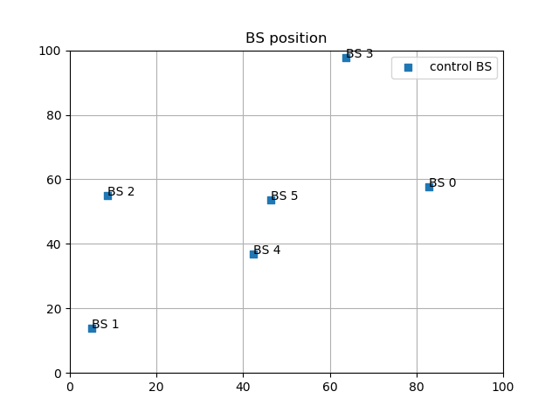
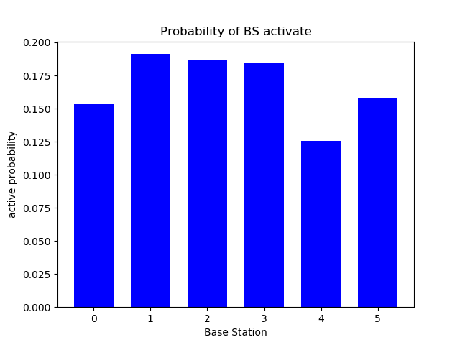
Simulation Result terminate at 10000 episode

Slide 22
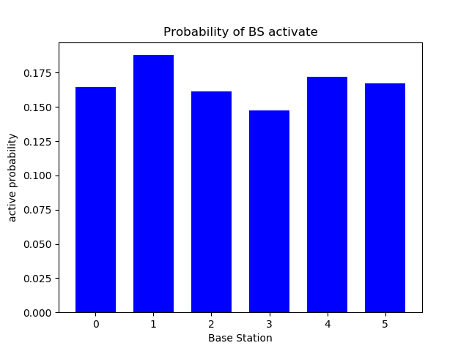
Simulation Result terminate at 20000 episode

Slide 23
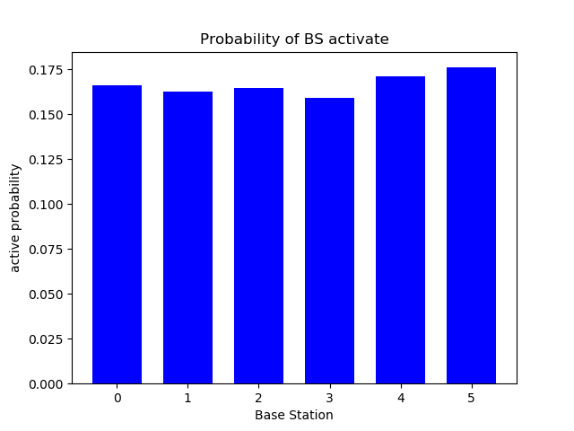
Simulation Result terminate at 50000 episode

Slide 24
Part 3
Future Study

Slide 25
Plan
Environment model
Consider LoS, BS Elevation, backhaul, Interference
Update association rule
Update SNR to SINR
RL model
Re-design reward
Re-design terminal condition
Apply other algorithms
Actor – Critic
MCTS

Slide 26
Thank you
Any Questions?
Email : tph02361@dgist.ac.kr, dlwogus4066@dgist.ac.kr

